Slide 1

Review of Snack Foods: Chips

Slide 2
Executive Summary
Chip Analysis Review
Trial Store Analysis

Slide 3
Chip Analysis Review
Every year, we notice that more people buy chips in the time before Christmas. This is a great time to have special sales to sell even more chips.
Kettle products the most popular chips, while 175g is the best-selling size.
Mainstream Young Singles & Couples are the primary shopper of chips.
The strong sales performance can be attributed primarily to several key factors: the substantial customer base in the latter two segments, the elevated average purchase quantities seen among young and older families, and the notably high average purchase prices observed among Mainstream midage and young singles/couples.

Slide 4
Trial Store Analysis
A control store was established to mirror the historical performance of the chosen trial store.
After implementing the new store layout the performance of the trial store and the control store were compared. The trial store saw significant uplift from the new store layout.
Trial stores 77 and 88 exhibited a noteworthy contrast in performance across a minimum of two out of the three trial months. In contrast, trial store 86 did not demonstrate such variations during the trial period.
However, when viewed holistically, the trial indicates a substantial uptick in sales.

Slide 5
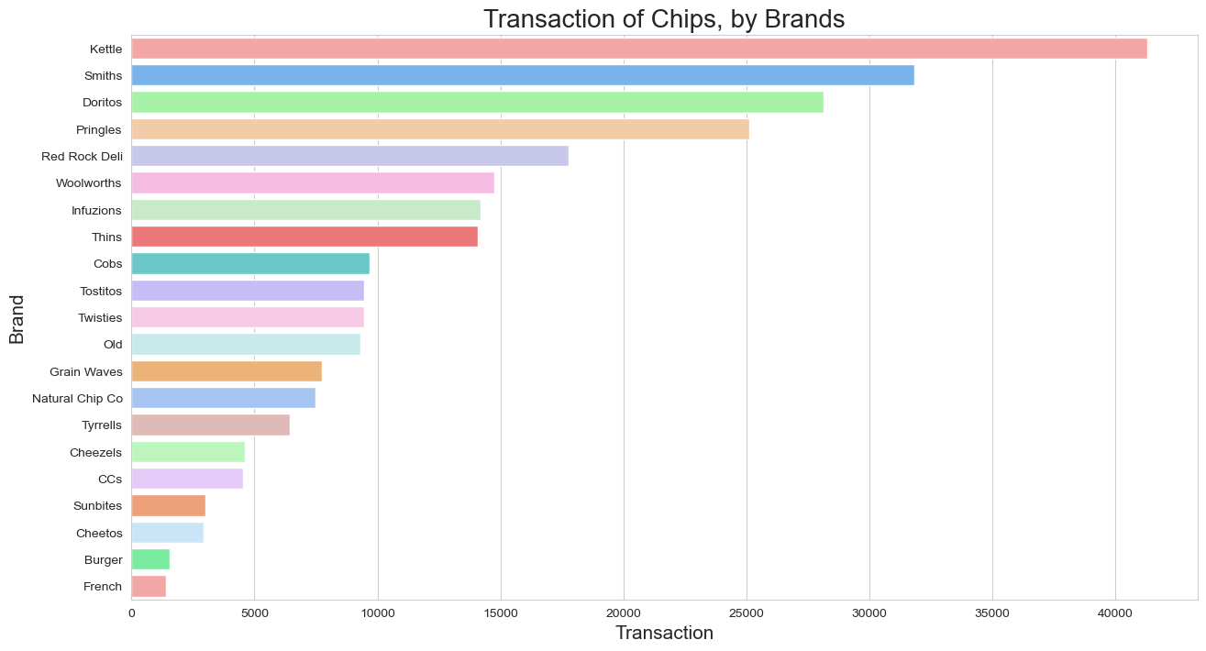
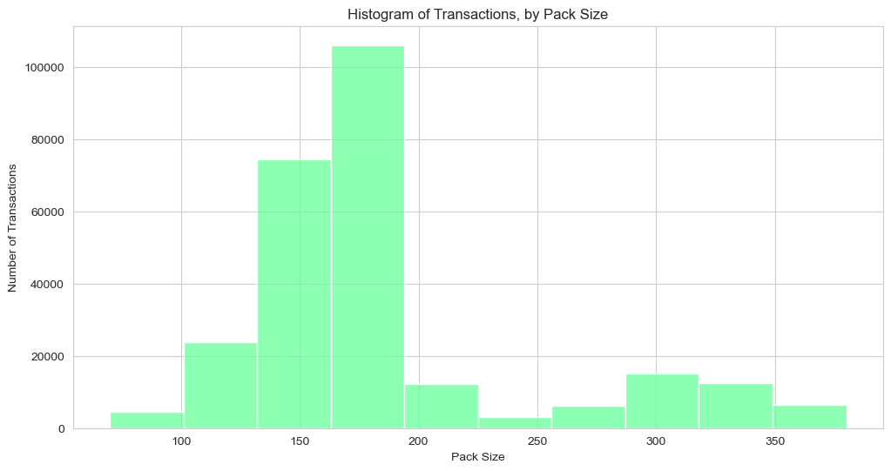
Most Popular brand and Package size
Kettle stands out as the top-selling brand, with 175g being the favored package size.

Slide 6
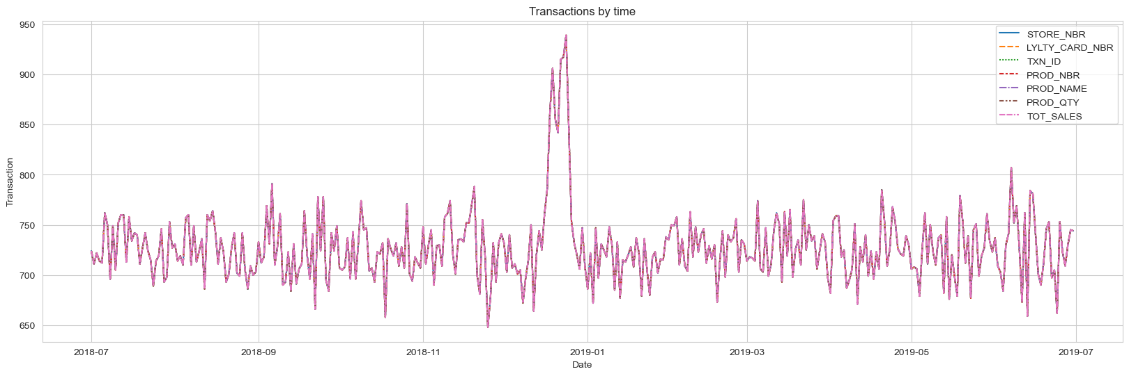
Transaction over time
Throughout the year, chip sales typically remain consistent, fluctuating within the range of 650 to 700 units. However, come December, there's a notable surge in sales, primarily attributed to the holiday season, with a noteworthy spike in activity. It's worth noting that the absence of sales on Christmas day itself can be attributed to the closure of shops during that time.

Slide 7
Factors influencing consumer purchasing behavior within the chips category.
Total Sales - Top 3 sales driver segments :
Budget - Older Families
Mainstream - Young Singles/Couples
Mainstream - Retirees
Other facts :
Customer counts : There are more Mainstream - young singles/couples and Mainstream - retirees who buy chips.
Average purchase quantity : Older families and young families in general buy more chips per customer.
Average purchase price : Mainstream midage and young singles/couples are more willing to pay more per packet of chips compared to their budget and premium counterparts (statistical significant).

Slide 8
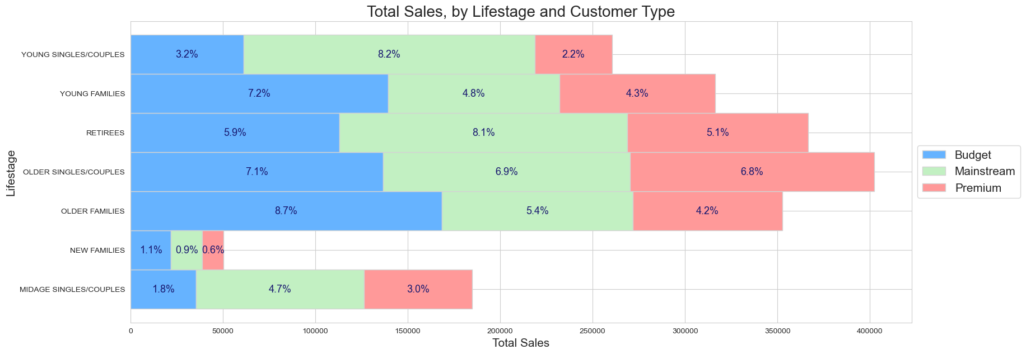
Visualizing the proportion of customers with respect to factor customer type and life stage(Total Sales)

Slide 9
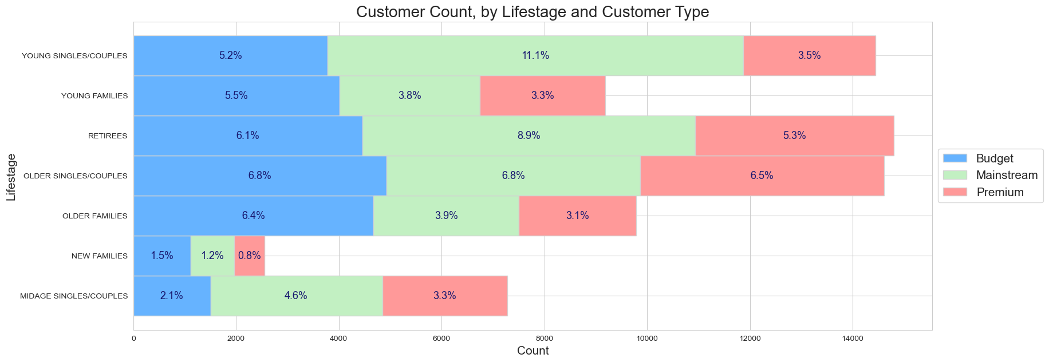
Visualizing the proportion of customers with respect to factor customer type and life stage (Customer Count)
It's evident that Mainstream - young singles/couples and Mainstream - retirees are the predominant consumer groups purchasing chips. This prominence in these segments notably boosts sales. However, it's essential to note that this factor doesn't exert a substantial influence on the Budget - Older families segment.

Slide 10
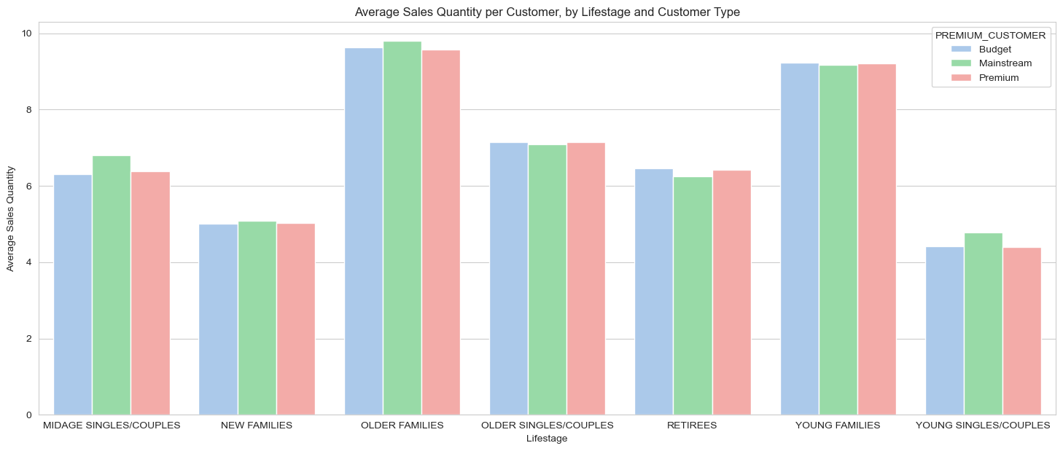
Average Sales Quantity per customer by Lifestage and Customer Type
In general, both Older families and Young families tend to purchase a higher quantity of chips per customer.

Slide 11
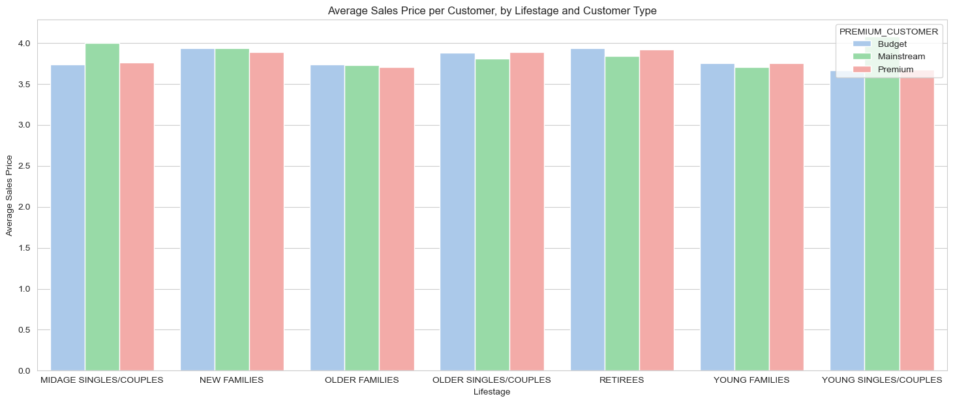
Average Sales Price per Customer by Life Stage and Customer Type
Mainstream midage and young singles/couples demonstrate a higher willingness to pay more per packet of chips compared to their counterparts in both the budget and premium segments.

Slide 12
Control store Vs Other Store
Trial Stores | Control Stores
77 | 233
88 | 237
86 | 155
Selection process for control stores is grounded in evaluating the average score
Total Sales and the Number of Customer
Correlation and Absolute difference between the trial store’s performance and each control store's performance

Slide 13
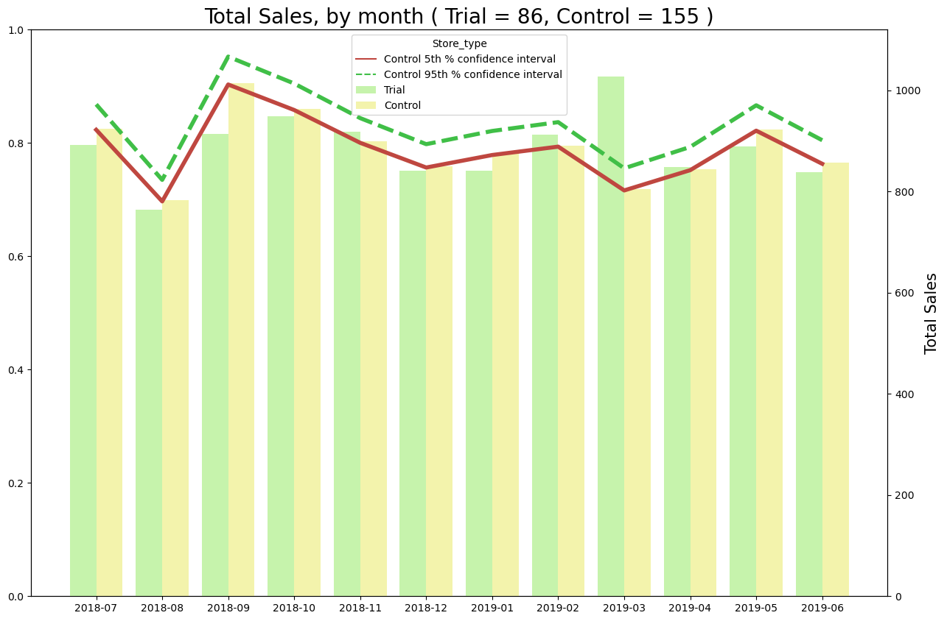
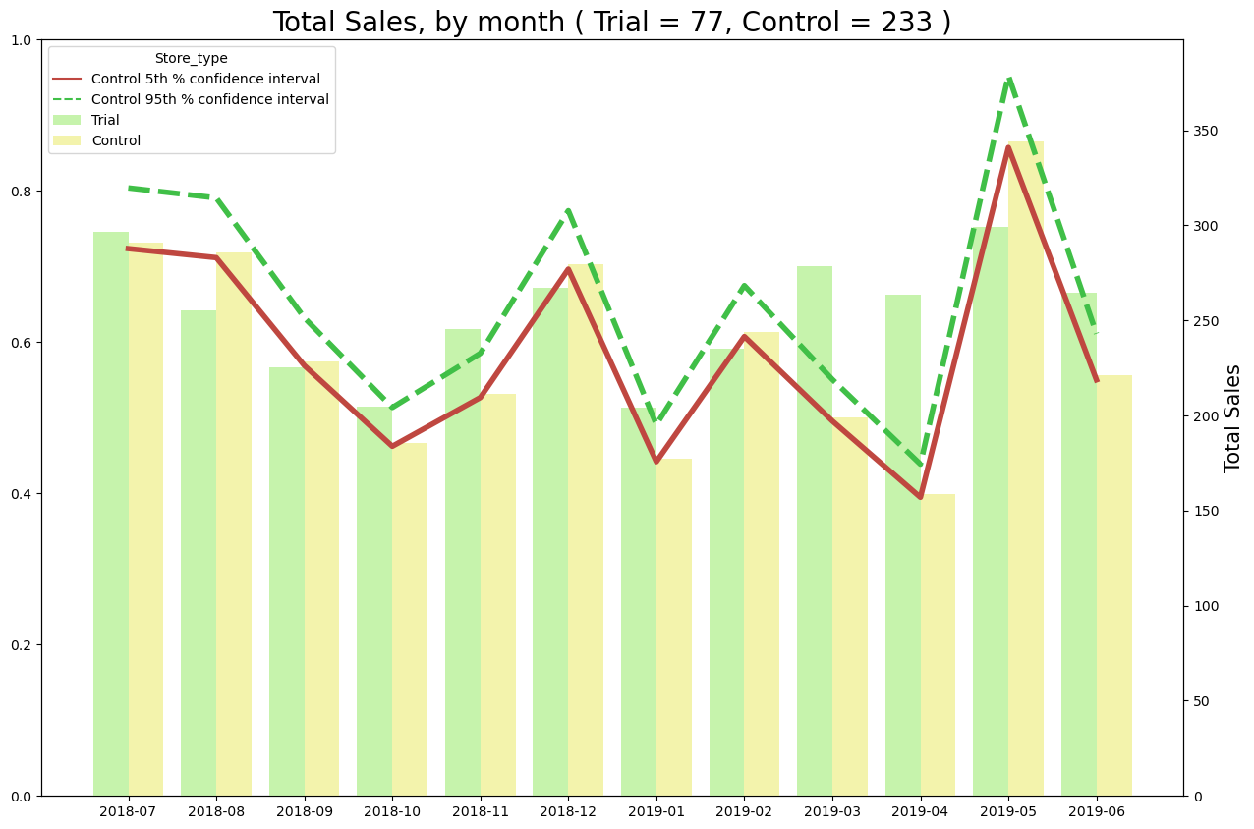
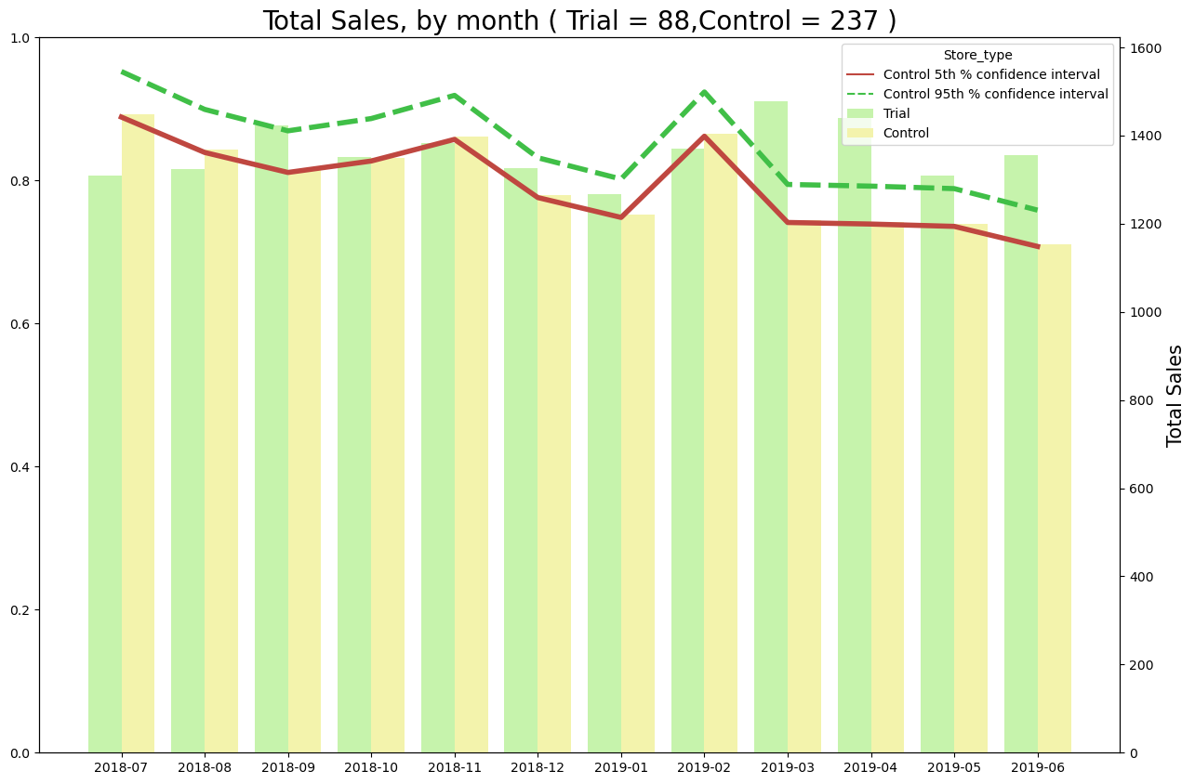
Performance in Trial store (Total Sales)
The findings indicate that there is a significant difference between the trial and its control store in the case of stores 77 and 88. However, for store 86, the trial does not yield a significant difference compared to its control store.

Slide 14
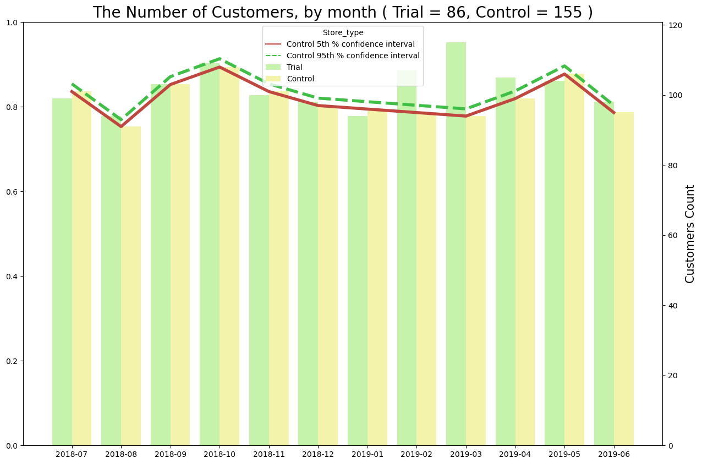
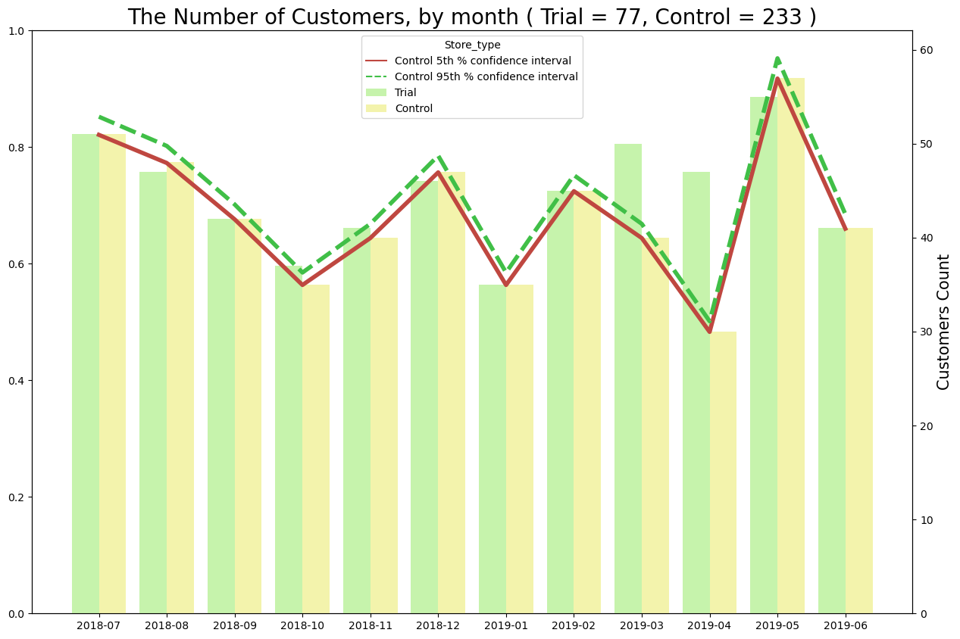
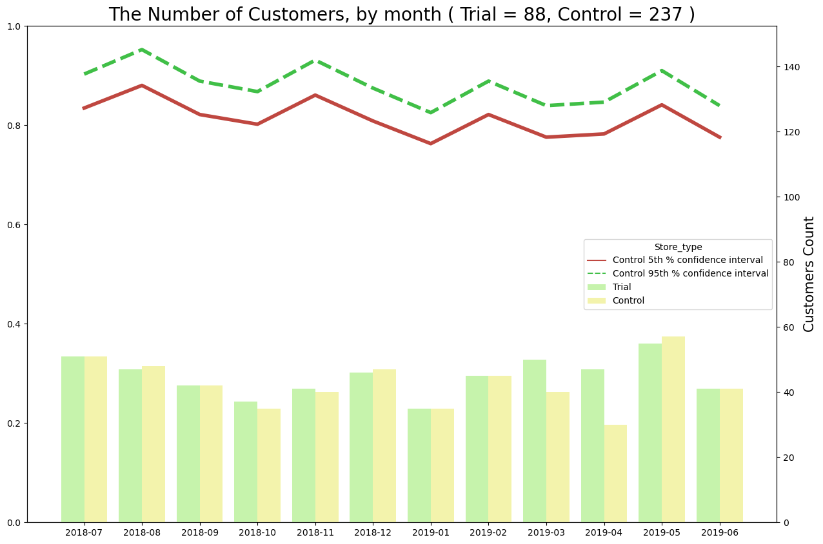
Performance in Trial Store (Customer Counts)
The results reveal that during the trial period, there is a significant difference between each trial store and its respective control store.

Slide 15
Recommendations
General :
Increase inventory and promotions in December
Increase sales promotion of Kettle (all size) and 175g (all brands) chips
Target segments :
Budget - Older Families :
Promotion like 'Buy Two Get One Free‘
Mainstream - Young Singles/Couples :
Target advertisements
Change the display area
Promotion and repackaging on popular brands and sizes
Mainstream - Retirees :
Target advertisements
Limited time sales promotions during daytime

Slide 16
Consult with the Category Manager to inquire about any special promotions or deals that might have been in place at the trial store, as these could potentially have influenced the outcomes by reducing prices.

